Slide 1


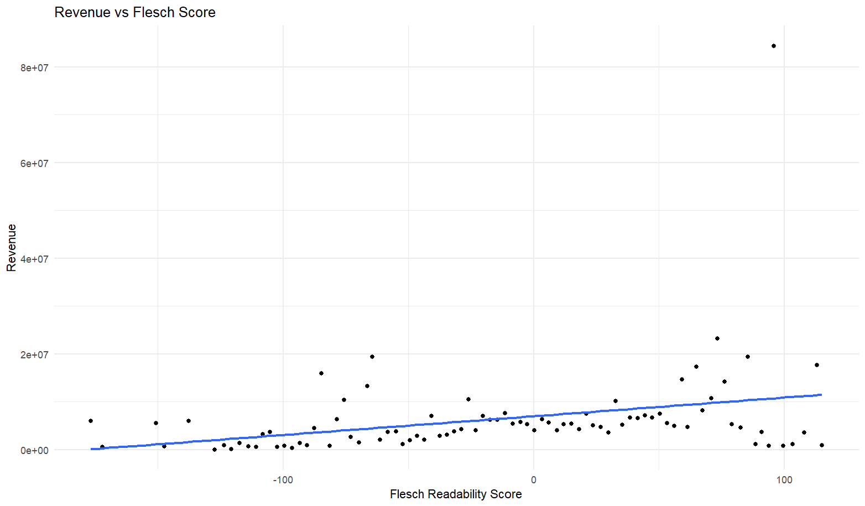
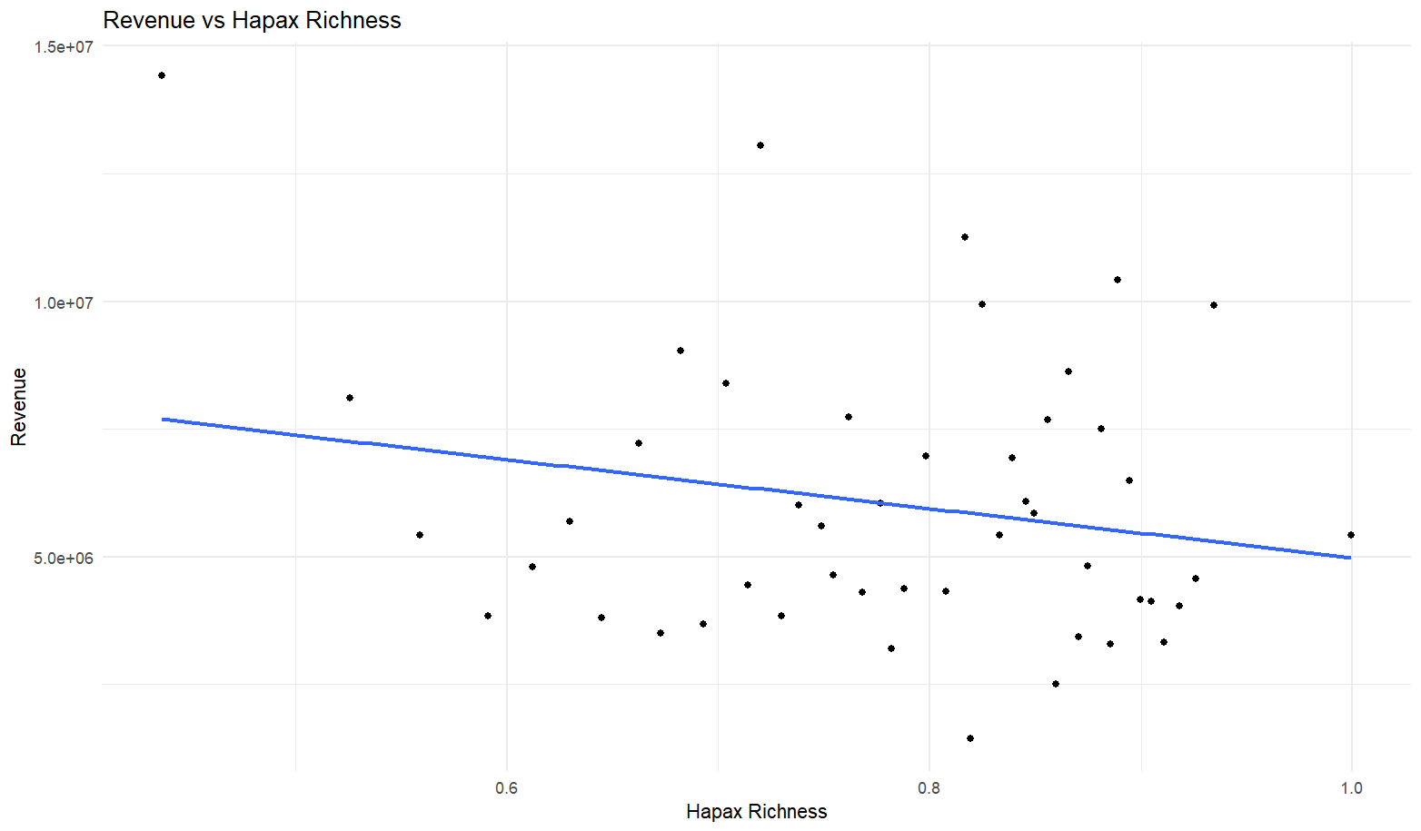
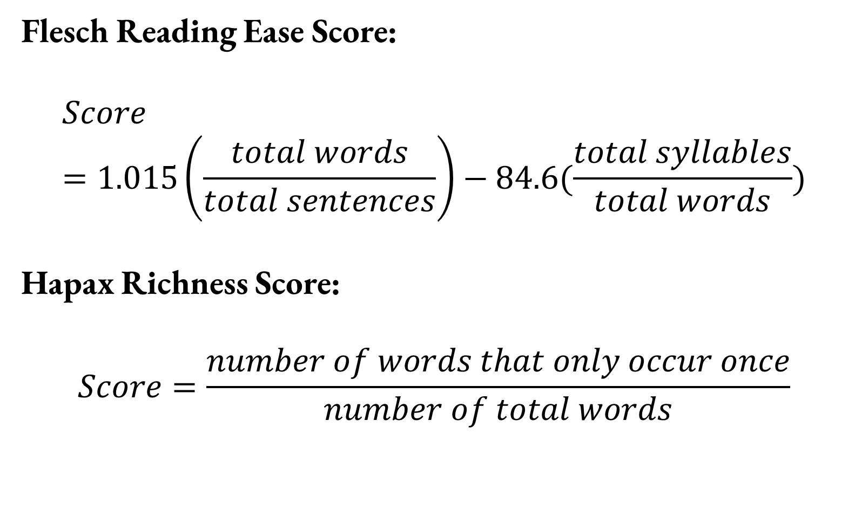
The Impact of Linguistic Features on Revenues using Natural Language Processing on Mission Statements of Tax-Exempt Organizations
Hariaksha Gunda*, Dr. Michael Price
Department of Economics, Finance, and Legal Studies
ABSTRACT
METHODOLOGY
FORMULAS
This research project provides a better understanding of the impact of mission statements of tax-exempt organizations on fundraising, specifically in the United States, Australia, the United Kingdom, and Canada. We utilize the Python Requests and BeautifulSoup libraries to web scrape mission statements, names, revenue, and other relevant data from the IRS, GuideStar, and Charity Navigator. After generating the data, we use techniques drawing from Natural Language Processing (NLP) and statistics to identify patterns in mission statements across different categories of tax-exempt organizations like religious charities and medical nonprofits. NLP libraries used include Natural Language Toolkit (NLTK), Regular Expressions (RegEx), and SpaCy. In full, this project provides insight into the impact of mission statement language on fundraising efforts. All project code, data, and documentation can be found at github.com/Hariaksha/NLP-Charity-Research.
Data Generation
Text Preprocessing
Preliminary Analysis
Machine Learning
Flesch Reading Ease Score:
$$Score=1.015\left(\frac{total words}{total sentences}\right)−84.6(\frac{total syllables}{total words})$$
Hapax Richness Score:
$$Score=\frac{number of words that only occur once}{number of total words}$$
Generate data by web scraping from the IRS, GuideStar, and Charity Navigator.
Use Python script with open-source libraries Requests, BeautifulSoup, and csv.
Store mission statements, revenue, assets, and other data in spreadsheets.
Text preprocessing is an essential step in NLP to transform unstructured data to clean data ready for analysis.
Use Python library SpaCy.
Steps include:
Tokenization
Lowercasing
Lemmatization
Stop-Word Removal
Part-of-Speech tagging
Named Entity Recognition
Perform linear regression to find relationships between linguistic features and revenue.
Readability Features:
Flesch Reading Ease score
Flesch-Kincaid Readability
Richness Features
Type-Token Ratio
Hapax Richness
Empathy Features
Donor-serving VS Society-serving missions
Separate data randomly into training and testing sets.
Create and evaluate a machine learning model that takes nonprofit information (asset code, state, mission statement, etc.) as input and outputs expected revenue.
Use Python library TensorFlow.
HYPOTHESES
Mission statement language will correlate with revenue of tax-exempt organizations.
Mission statements with language identifying as more donor-serving will correlate with higher revenue.
The effects of mission statement language on revenue will be less powerful for tax-exempt organizations with higher asset codes.
The effects of mission statement language on revenue will differ slightly among categories of tax-exempt organizations, such as education versus health nonprofits.
BACKGROUND
Natural Language Processing:
Natural Language Processing (NLP) is the branch of Artificial Intelligence that enables computers to understand, manipulate, and generate human language.
This technology is vital for many applications involving unstructured and textual data.
Nonprofits in America:
Most nonprofits are small and community-based, and 92% operate with less than $1 million a year.
There are 1,859,826 tax-exempt organizations in the country.
Language and Impact:
Prior research suggests that mission statement language correlates with economic and organizational performance (2, 3).
PRELIMINARY RESULTS
FUTURE STEPS
The next steps are:
Generate and process data from the United Kingdom, Australia, and Canada.
Analyze the data for linguistic features and trends.
Train ML model on training data to estimate revenue of tax-exempt organization given mission statement and asset code.
Test ML on testing data.
MOTIVATION
$$Revenue_{i}=α_{i}+β_{i}Flesch_{i}+ε_{i}$$
$$Revenue_{i}=α_{i}+β_{i}Hapax_{i}+ε_{i}$$
The nonprofit sector largely consists of small, community-based organizations working with meager resources. For this reason, nonprofits rely on resources and research to operate more effectively. Prior researchers have begun to understand the impact of different linguistic structures and patterns on economic and organizational performance. This project furthers these efforts by addressing a research gap surrounding empathy and compassion in mission statements. We evaluate the impact of “Self VS Other" linguistic structures on revenues of tax-exempt organizations. This research will provide a better understanding of the impact of linguistic features and can be applied to increase charitable donations and elevate the impact of a wide array of nonprofits, thereby touching the lives of countless individuals.
Coefficients: | Estimate | Std. Error | T-value | P-value
Intercept | 5259616 | 336827 | 15.615 | < 2e^-16
Flesch Score | 34417 | 10224 | 3.366 | 0.000762
Coefficients: | Estimate | Std. Error | T-value | P-value
Intercept | 10571871 | 1708334 | 6.188 | 6.1e^-10
Hapax Richness | -5152904 | 1893517 | -2.721 | 0.0065
REFERENCES
[1] Yaden, D. B., Giorgi, S., Jordan, M., Buffone, A., Eichstaedt, J. C., Schwartz, H. A., Ungar, L., & Bloom, P. (2024). Characterizing empathy and compassion using computational linguistic analysis. Emotion, 24(1), 106–115. https://doi-org.libdata.lib.ua.edu/10.1037/emo0001205.supp (Supplemental)
[2] Baek, Y. M., Ihm, J., & Kang, C. H. (2023). Does mission concreteness make a difference in nonprofit performance? Automated text analysis approach to the importance of concrete mission statements. Nonprofit Management & Leadership, 34(2), 409–431. https://doi-org.libdata.lib.ua.edu/10.1002/nml.21570
[3] Ward, B. (2023). Relationship Between Mission Statement Components and ROA: A Study of Small-Cap Financial Firms. IUP Journal of Business Strategy, 20(4), 5–19.
Name | NTEE | Revenue | Preprocessed Mission
Alaska Veterans Museum | A54 | $99949 | create museum inspiration, remembrance preservation veterans sacrifices america freedom
Alaska Childrens Alliance | I72 | 333022 | dedicate strengthen multi-disciplinary response child abuse.
Sacred Valley Health | Q33 | 173068 | mission Sacred Valley Health improve health under-served rural of Peru's Sacred through health and education increased access to health services community empowerment
Table 1: Preprocessed Missions and Revenues of Tax-Exempt Organizations

